Slide 1
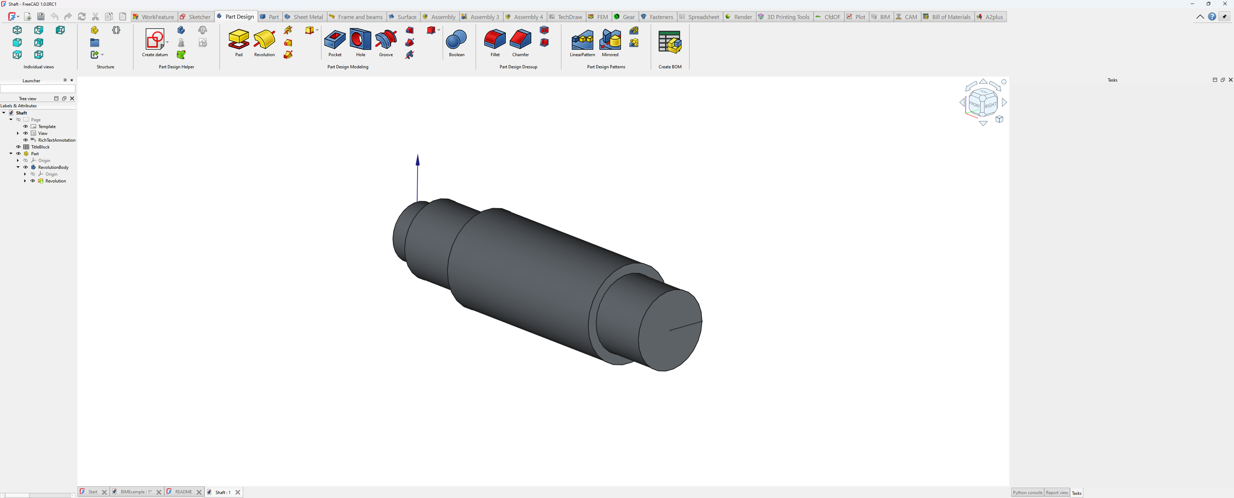
Application menu
Quick access toolbar
Ribbon tab bar
Ribbon panel
Right toolbar

Slide 2
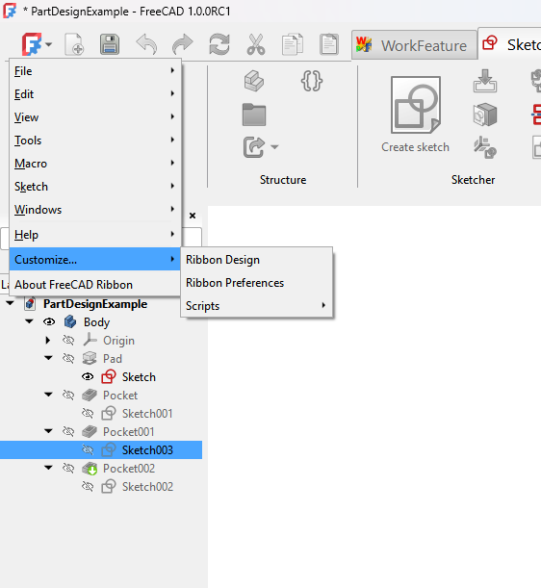
FreeCAD menus
Ribbon customize menus
Link to the home page in the wiki

Slide 3
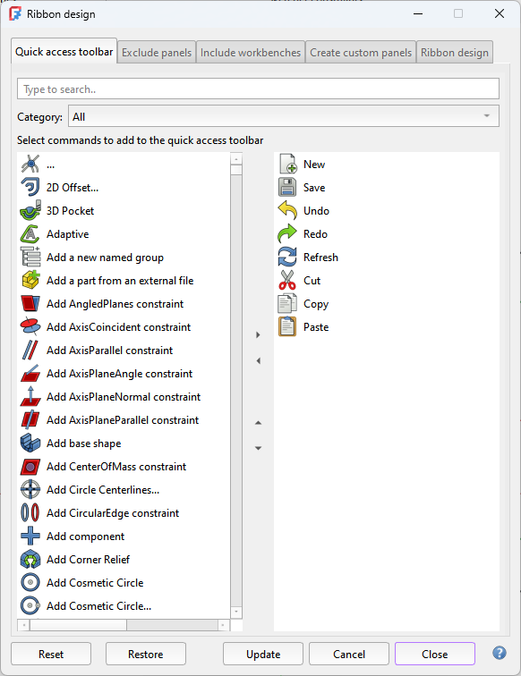
Tab bar
Link to the wiki page

Slide 4
Filter section
Commands to add
Added commands
Add or remove the selected command(s)
Move selected command up or down

Slide 5
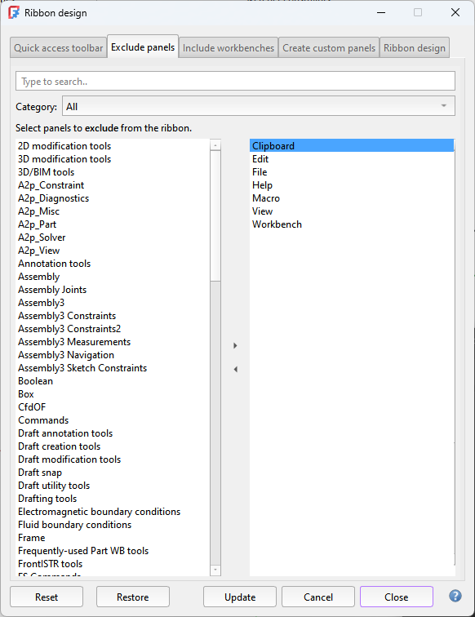
Filter section
Commands to add
Added commands

Slide 6
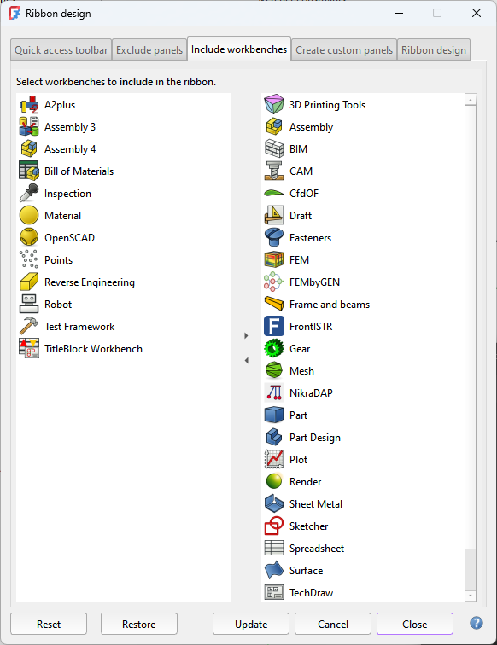
Workbenches to add
Added workbenches
Add or remove the selected workbench

Slide 7
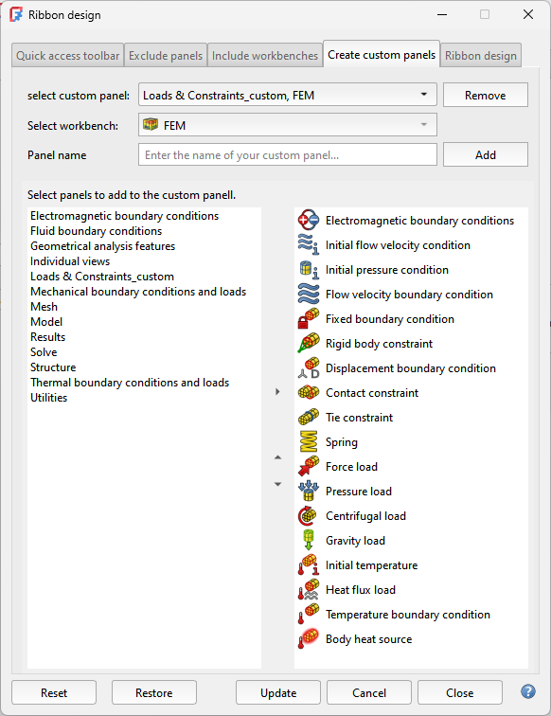
Select existing custom panels or select “New”
Remove a custom panel
Select a workbench
Input box to enter the name of a new custom panel
Add a custom panel
Toolbars to add
Commands of added toolbars
Add the selected toolbar(s)
Move selected commands up or down

Slide 8
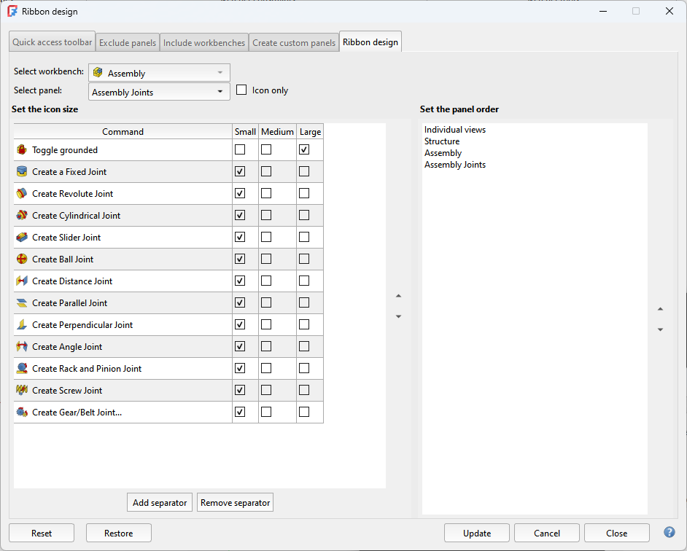
Set the size of the command buttons
Select a workbench
Select a toolbar
Double click to enter a different name
Move selected panel up or down
Move selected commands up or down
Add a separator above the selected command
Remove a separator

Slide 9
